Slide 1
Foundations of Machine Learning
Module 4:
Part A: Probability Basics
Sudeshna Sarkar
IIT Kharagpur

Slide 2
Probability is the study of randomness and uncertainty.
A random experiment is a process whose outcome is uncertain.
Examples:
Tossing a coin once or several times
Tossing a die
Tossing a coin until one gets Heads
...

Slide 3
Events and Sample Spaces
Sample Space
The sample space is the set of all possible outcomes.
Event
An event is any collection of one or more simple events
Simple Events
The individual outcomes are called simple events.

Slide 4
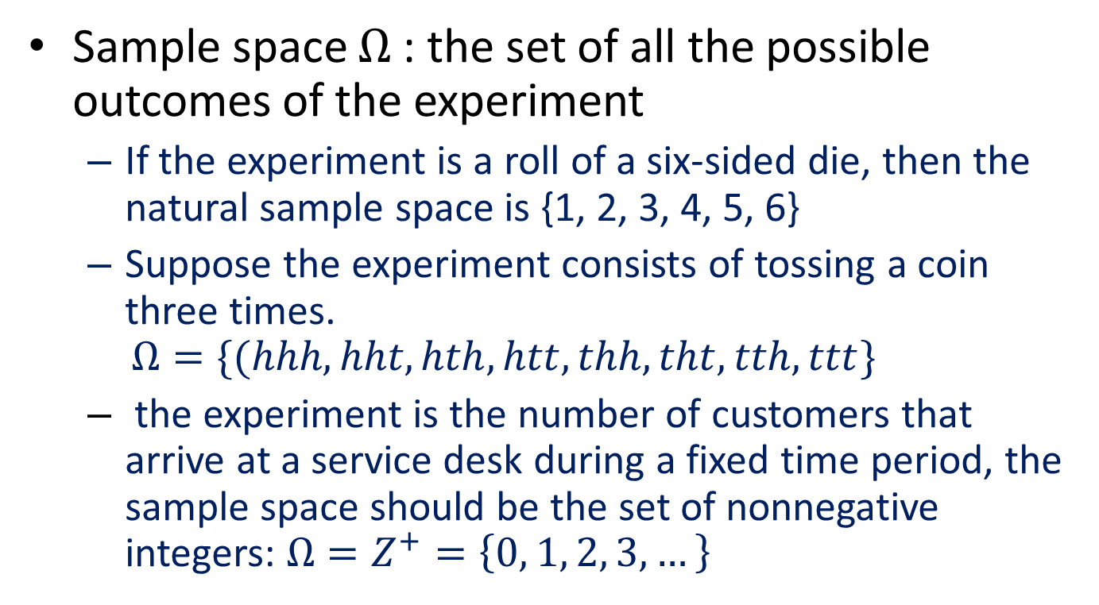
Sample Space
Sample space $Ω$ : the set of all the possible outcomes of the experiment
If the experiment is a roll of a six-sided die, then the natural sample space is {1, 2, 3, 4, 5, 6}
Suppose the experiment consists of tossing a coin three times. $Ω=\{(hhh, hht, hth, htt, thh, tht, tth, ttt\}$
the experiment is the number of customers that arrive at a service desk during a fixed time period, the sample space should be the set of nonnegative integers: $Ω=Z^{+}=\left\{0, 1, 2, 3, …\right\}$

Slide 5
Events
Events are subsets of the sample space
A= {the outcome that the die is even} ={2,4,6}
B = {exactly two tosses come out tails}=(htt, tht, tth}
C = {at least two heads} = {hhh, hht, hth, thh}

Slide 6
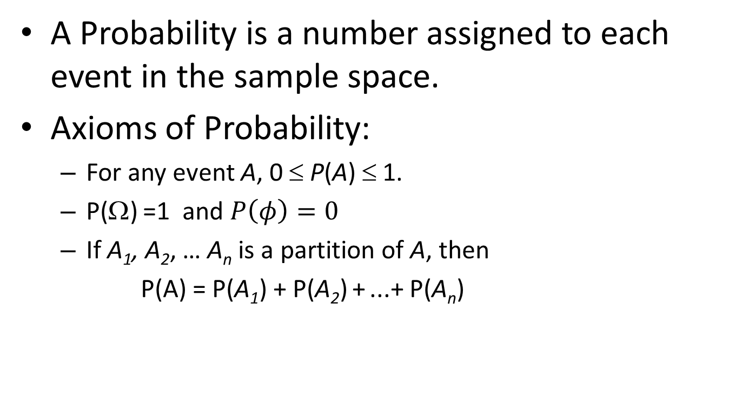
Probability
A Probability is a number assigned to each event in the sample space.
Axioms of Probability:
For any event A, 0 ≤ P(A) ≤ 1.
P(Ω) =1 and $P\left(φ\right)=0$
If A₁, A₂, … A_{n} is a partition of A, then
P(A) = P(A₁) + P(A₂) + ...+ P(A_{n})

Slide 7
Properties of Probability
For any event A, P(A^{c}) = 1 - P(A).
If A ⊂ B, then P(A) ≤ P(B).
For any two events A and B,
P(A ∪ B) = P(A) + P(B) - P(A ∩ B).
For three events, A, B, and C,
P(A∪B∪C) =
P(A) + P(B) + P(C)
- P(A∩B) - P(A∩C) - P(B∩C)
+ P(A∩B ∩C)

Slide 8
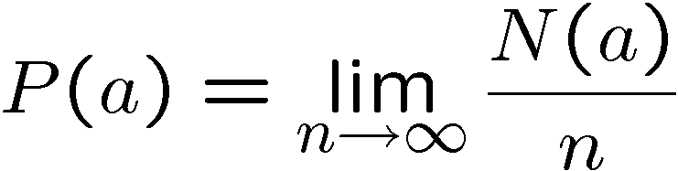
Intuitive Development (agrees with axioms)
Intuitively, the probability of an event a could be defined as:
Where N(a) is the number that event a happens in n trials

Slide 9
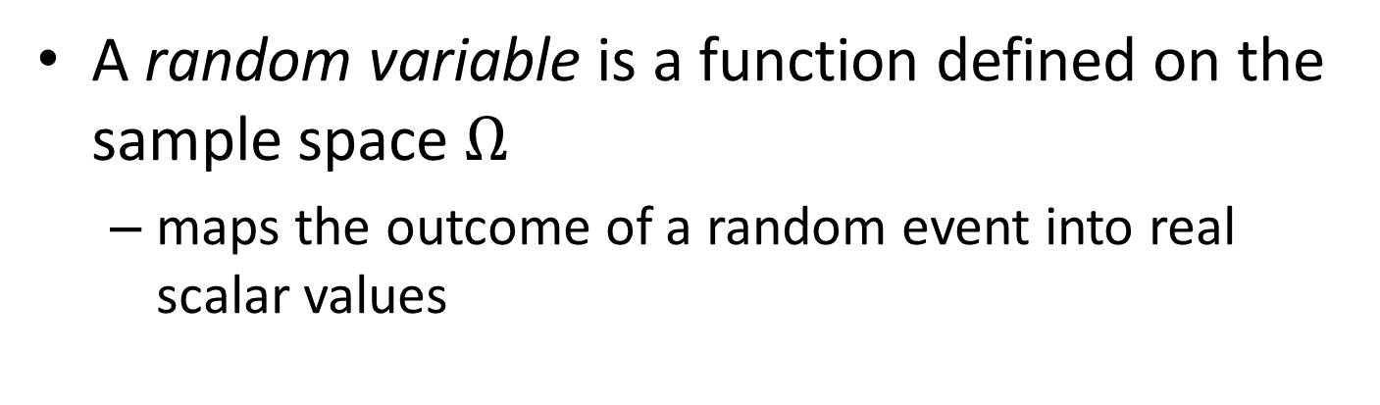
Random Variable
A random variable is a function defined on the sample space $Ω$
maps the outcome of a random event into real scalar values
Ω
X(ω)
ω

Slide 10
Discrete Random Variables
Random variables (RVs) which may take on only a countable number of distinct values
e.g., the sum of the value of two dies
X is a RV with arity k if it can take on exactly one value out of k values,
e.g., the possible values that X can take on are 2, 3, 4, 5, 6, 7, 8, 9, 10, 11, 12

Slide 11
Probability of Discrete RV
Probability mass function (pmf):
Simple facts about pmf
if
if

Slide 12
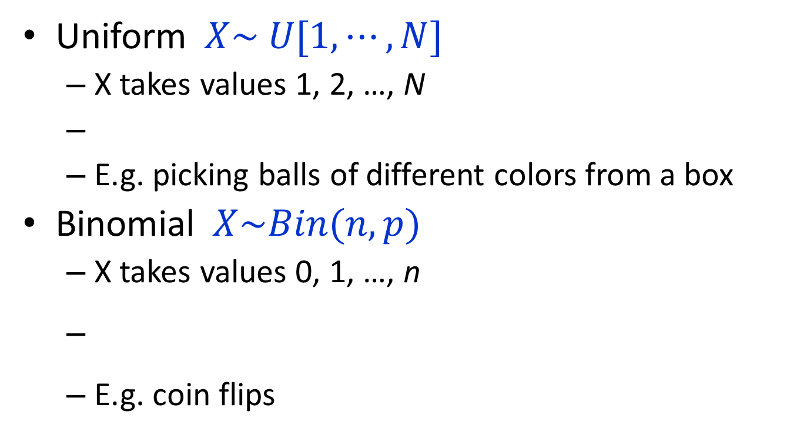
Common Distributions
Uniform $X\sim U[1, ⋯,N]$
X takes values 1, 2, …, N
E.g. picking balls of different colors from a box
Binomial $X\sim Bin(n,p)$
X takes values 0, 1, …, n
E.g. coin flips

Slide 13
Joint Distribution
Given two discrete RVs X and Y, their joint distribution is the distribution of X and Y together
e.g. you and your friend each toss a coin 10 times P(You get 5 heads AND you friend get 7 heads)

Slide 14
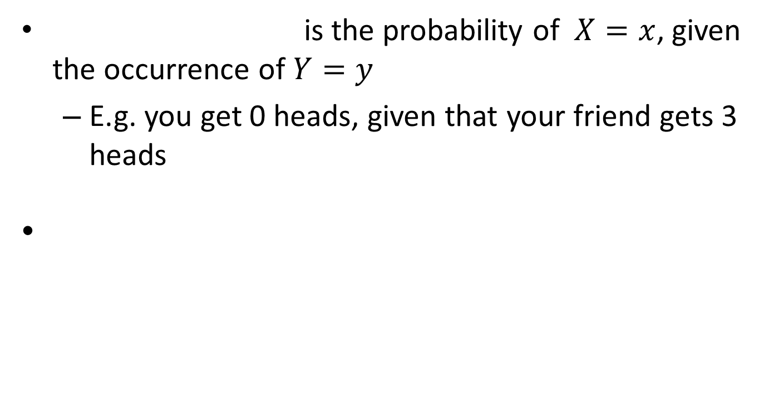
Conditional Probability
is the probability of $X=x$, given the occurrence of $Y=y$
E.g. you get 0 heads, given that your friend gets 3 heads

Slide 15
Law of Total Probability
Given two discrete RVs X and Y, which take values in
and , We have

Slide 16
Marginalization
Marginal Probability
Joint Probability
Conditional Probability
Marginal Probability

Slide 17
Bayes Rule
X and Y are discrete RVs…

Slide 18
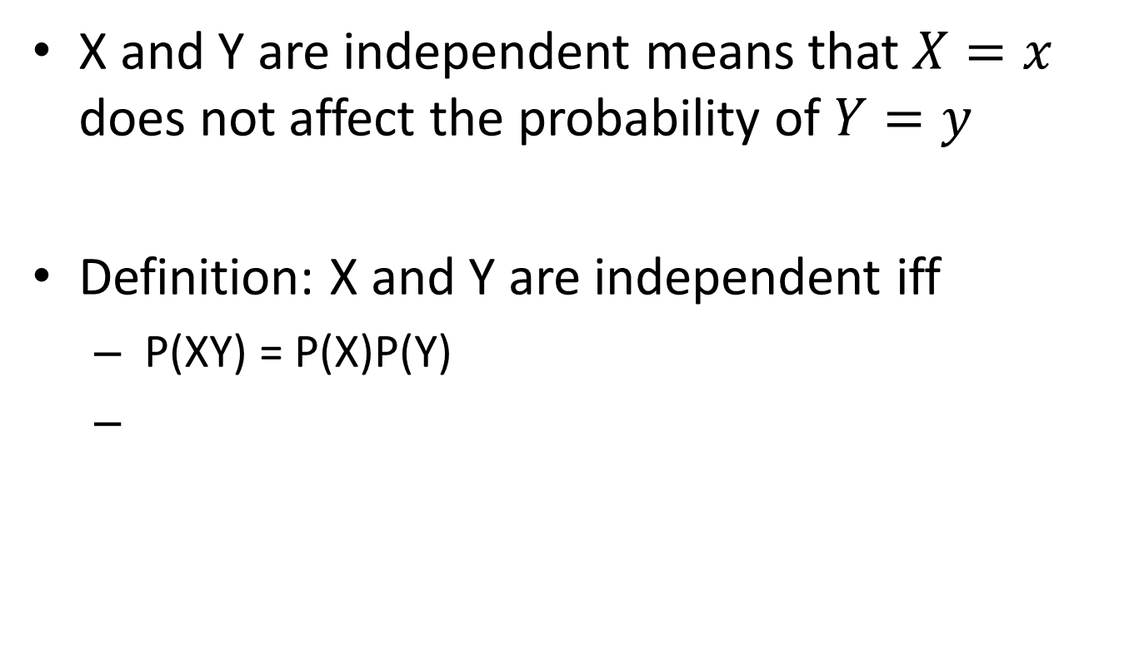
Independent RVs
X and Y are independent means that $X=x$ does not affect the probability of $Y=y$
Definition: X and Y are independent iff
P(XY) = P(X)P(Y)

Slide 19
More on Independence
E.g. no matter how many heads you get, your friend will not be affected, and vice versa

Slide 20
Conditionally Independent RVs
Intuition: X and Y are conditionally independent given Z means that once Z is known, the value of X does not add any additional information about Y
Definition: X and Y are conditionally independent given Z iff

Slide 21
More on Conditional Independence

Slide 22
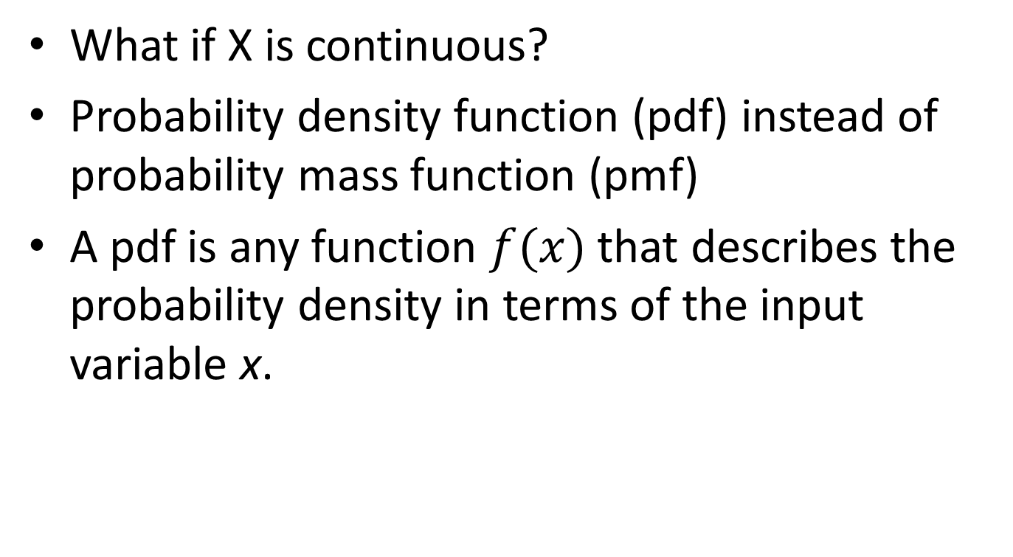
Continuous Random Variables
What if X is continuous?
Probability density function (pdf) instead of probability mass function (pmf)
A pdf is any function $f(x)$ that describes the probability density in terms of the input variable x.

Slide 23
PDF
Properties of pdf
Actual probability can be obtained by taking the integral of pdf
E.g. the probability of X being between 0 and 1 is

Slide 24
Cumulative Distribution Function
Discrete RVs
Continuous RVs

Slide 25

Common Distributions
Normal $X\sim N(μ,σ^{2})$
E.g. the height of the entire population

Slide 26
Multivariate Normal
Generalization to higher dimensions of the one-dimensional normal
Covariance Matrix
Mean

Slide 27
Mean and Variance
Mean (Expectation):
Discrete RVs:
Continuous RVs:
Variance:
Discrete RVs:
Continuous RVs:

Slide 28
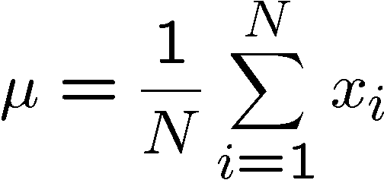
Mean Estimation from Samples
Given a set of N samples from a distribution, we can estimate the mean of the distribution by:

Slide 29
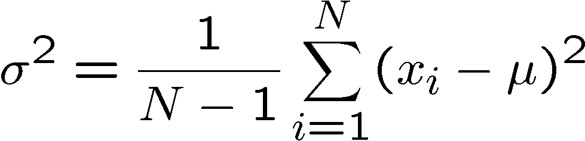
Variance Estimation from Samples
Given a set of N samples from a distribution, we can estimate the variance of the distribution by:

Slide 30
Thank You

